Slide 1
Introduction to Machine Learning and Control for Building Energy Systems
Ján Drgoňa
Associate Professor @ CaSE & ROSEI

Slide 2
Grading and Course Expectations
Participation 10%
Homework 30% - week 3-5
Project proposal 10% - week 6
Project progress report 10% - week 8
Project final report 20% - week 10
Project presentation 20% - week 11

Slide 3
Course Syllabus
Week 1: Introduction to Building Energy Systems
Week 2: HVAC systems and heat transfer modeling
Week 3: Dynamical systems fundamentals
Week 4: Control systems fundamentals
Week 5: Machine learning fundamentals - with HVAC load forecasting example
Week 6: System identification - with thermal dynamics modeling example
Week 7: Constrained optimization fundamentals
Week 8: Optimal control fundamentals
Week 9: Model predictive control of building energy systems
Week 10: Practical implementation aspects and high-fidelity building emulators
Week 11: Project evaluation with presentations

Slide 4
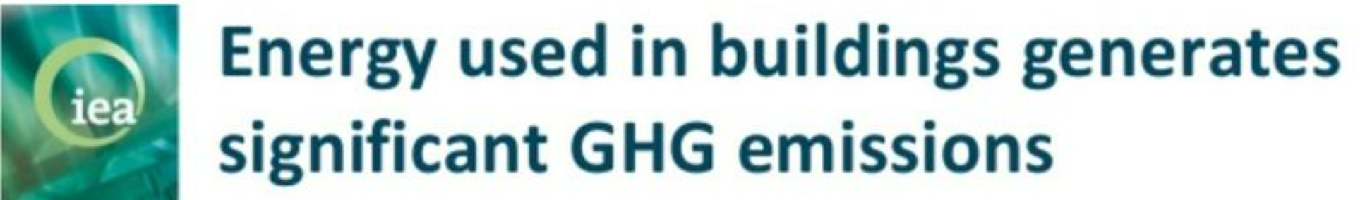
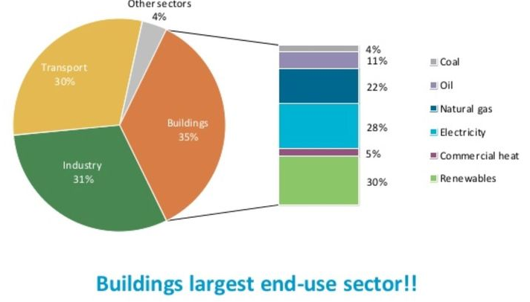
HVAC Systems and Heat Transfer Modeling
Why?
HVAC systems regulate indoor air quality, temperature, and humidity in buildings. They are essential for creating comfortable, healthy, and energy-efficient indoor environments.
HVAC systems are significant contributors to global energy use. Buildings account for approximately 35% of global final energy use, where HVAC accounts for approximately 40% of total building use.
The energy use attributed to HVAC systems is expected to grow, underscoring the importance of enhancing energy efficiency in these systems.
How?
Time: How AI Is Making Buildings More Energy-Efficient
https://time.com/7201501/ai-buildings-energy-efficiency/
Wired: Cutting-Edge Technology Could Massively Reduce the Amount of Energy Used for Air Conditioning
https://www.wired.com/story/cutting-edge-technology-could-massively-reduce-the-amount-of-energy-used-for-air-conditioning/
https://www.eia.gov/tools/faqs/faq.php?id=1174&t=1 https://www.iea.org/energy-system/buildings

Slide 5
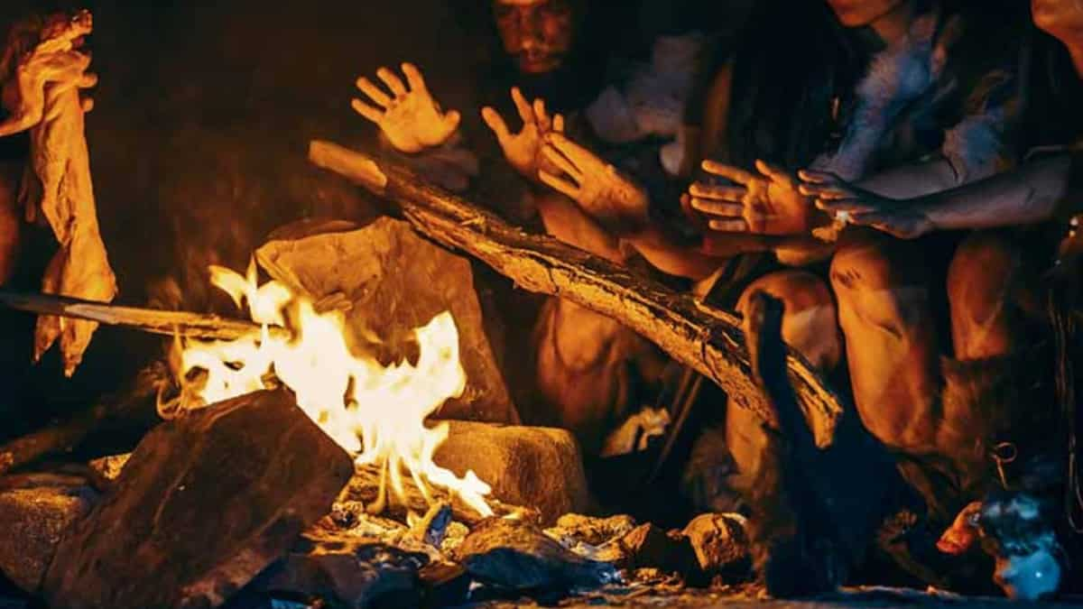
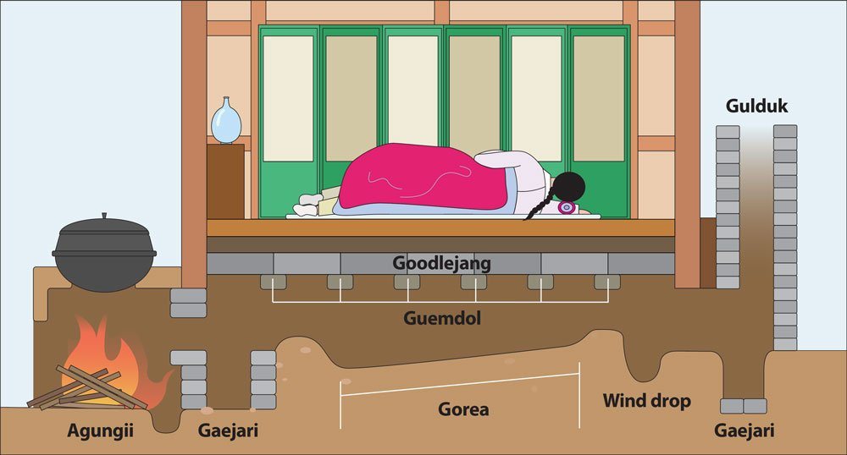
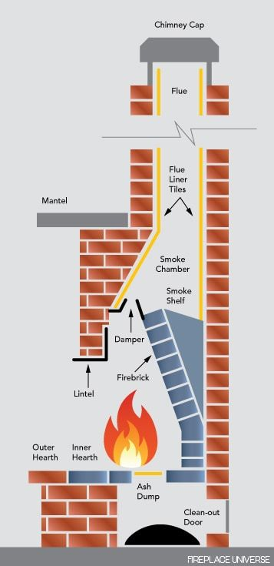
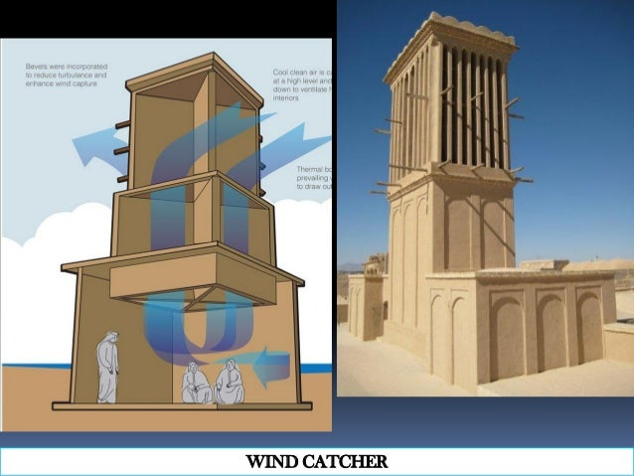
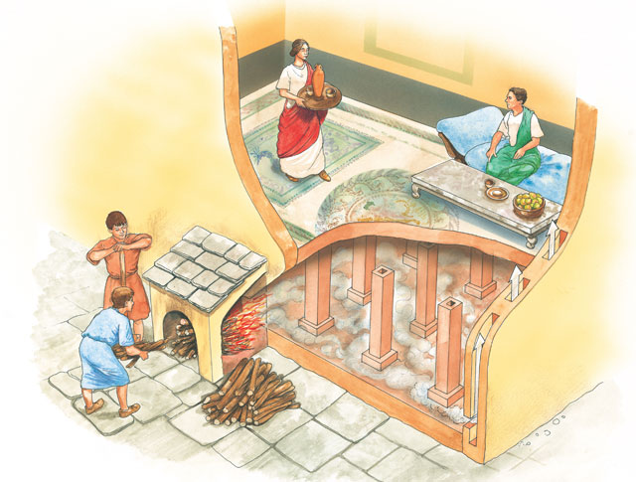
History of HVAC Systems
Cave fire (300000 BCE)
Korean Ondol (1000 BCE)
Persian wind catcher (1000 BCE)
Roman Hypocaust (100 BCE)
Chimneys and fireplaces (Medieval)

Slide 6
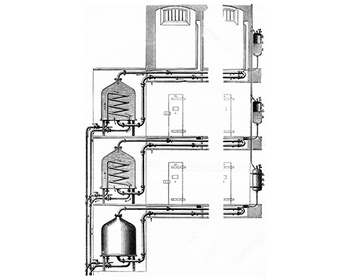
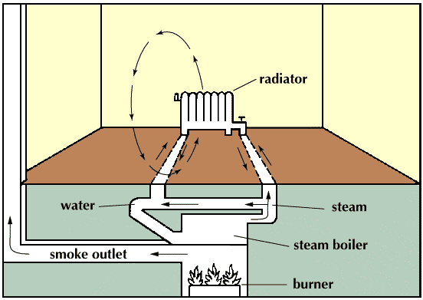
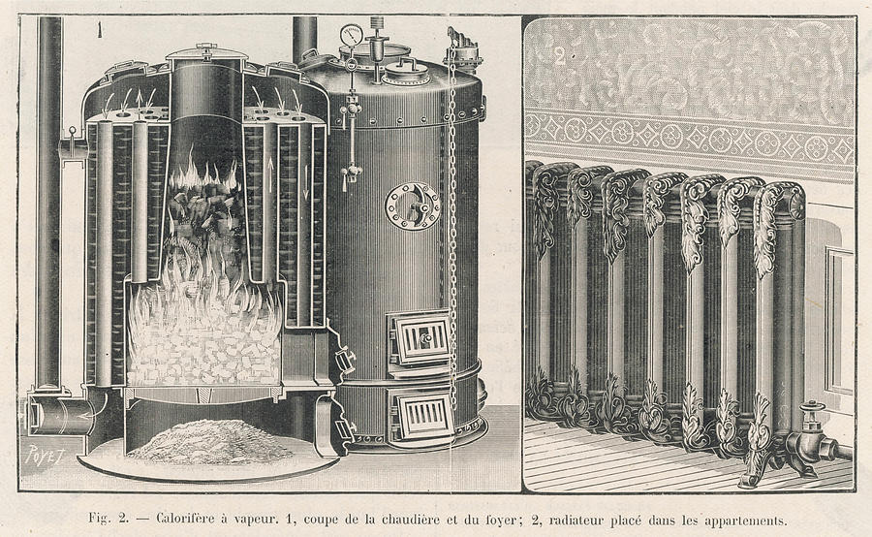
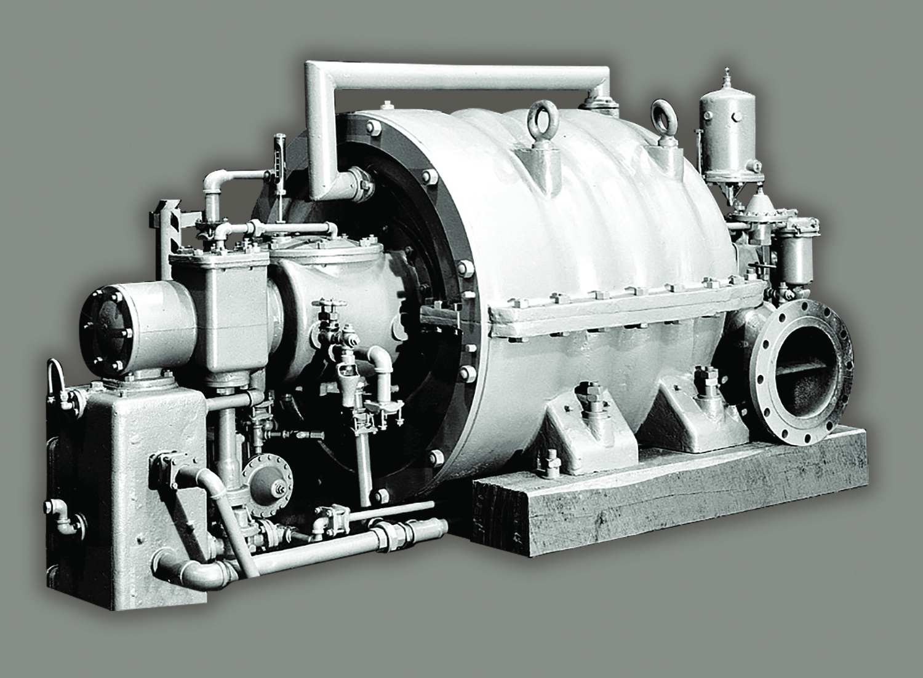
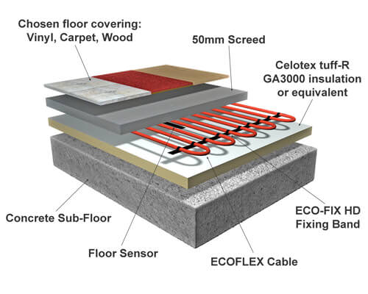
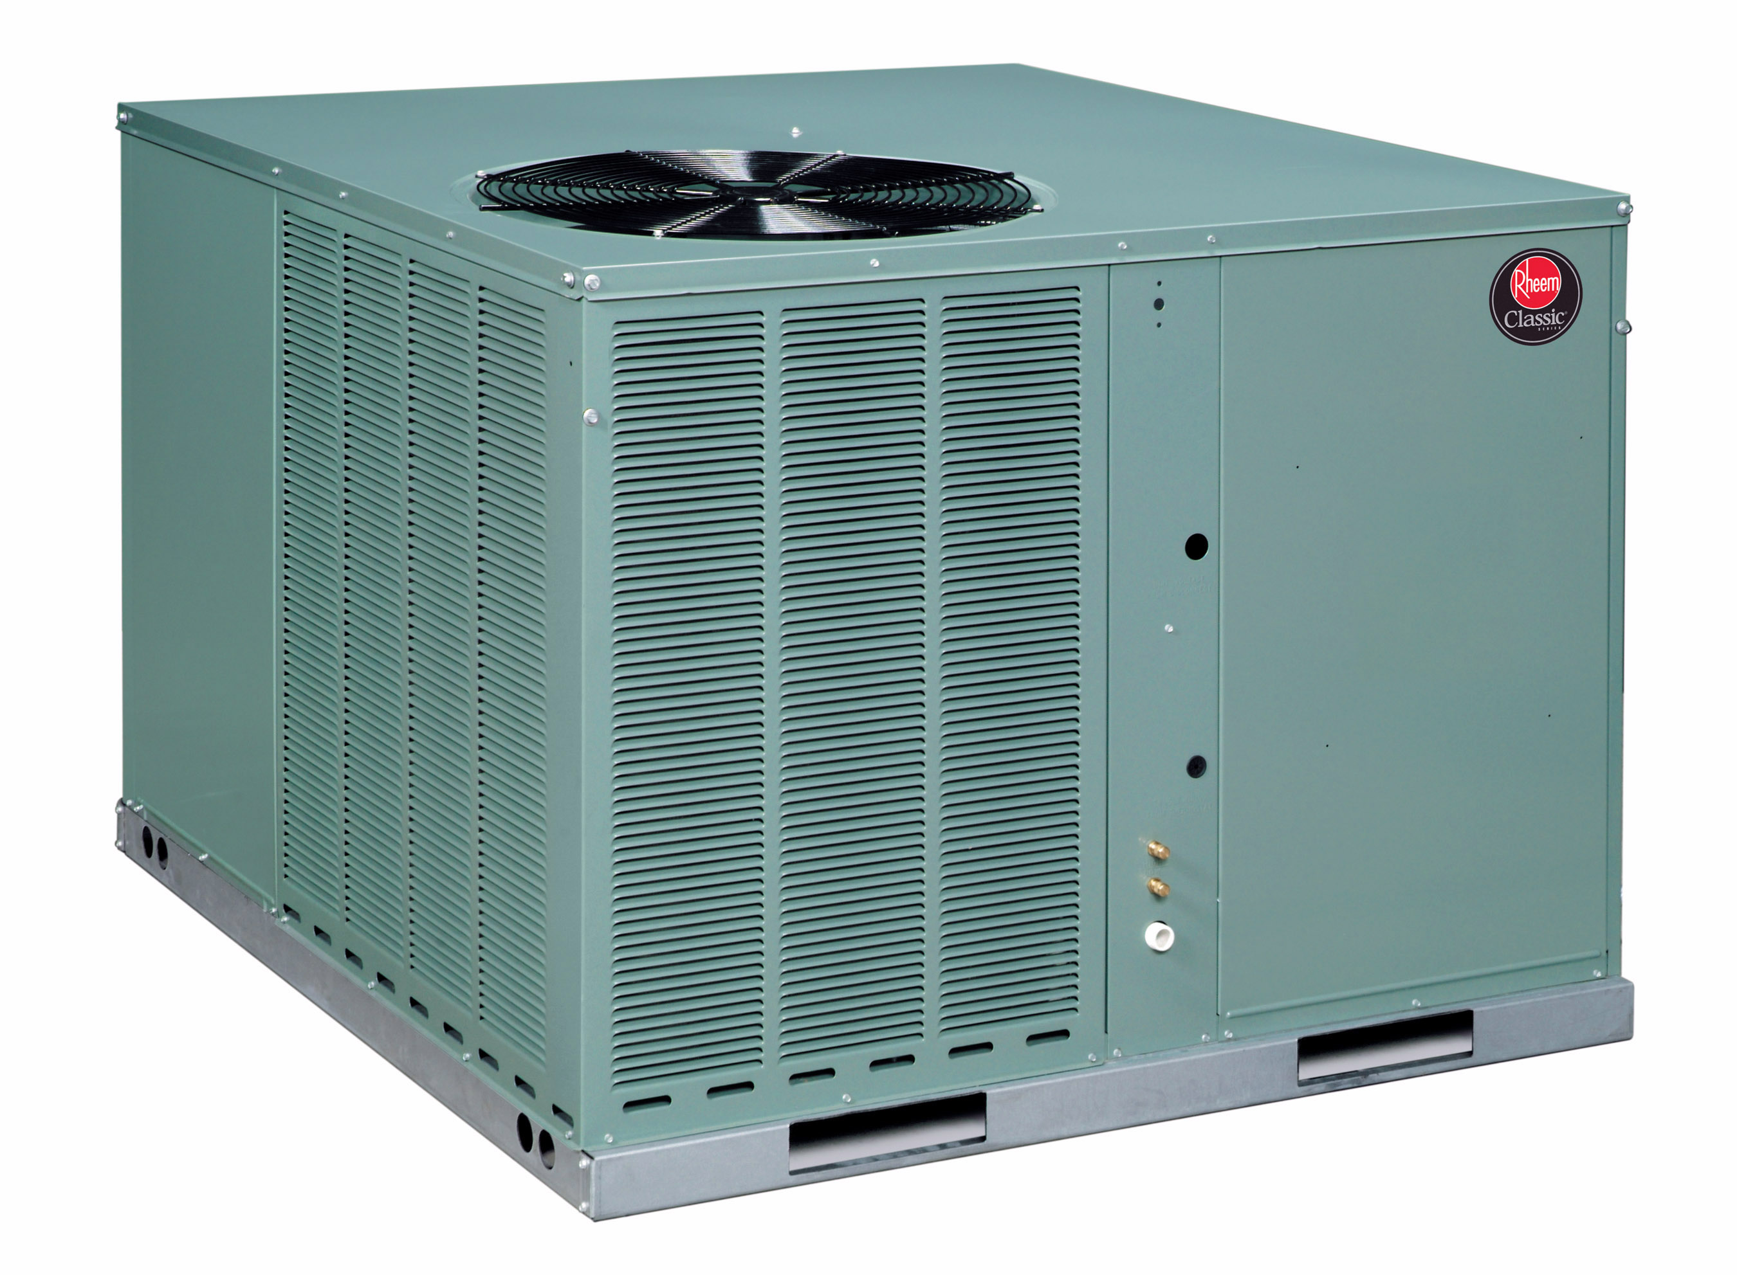
History of HVAC Systems
Radiators and steam central heating systems (1800)
Hot water heating and forced air (1900)
First AC developed by Carrier (1922)
Radiant HVAC (1970)
Heat pumps (1980)

Slide 7
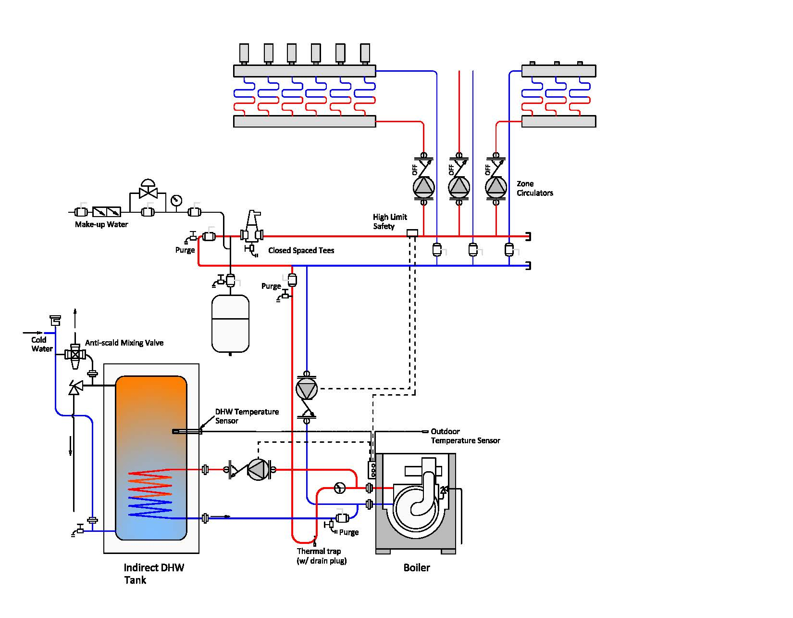
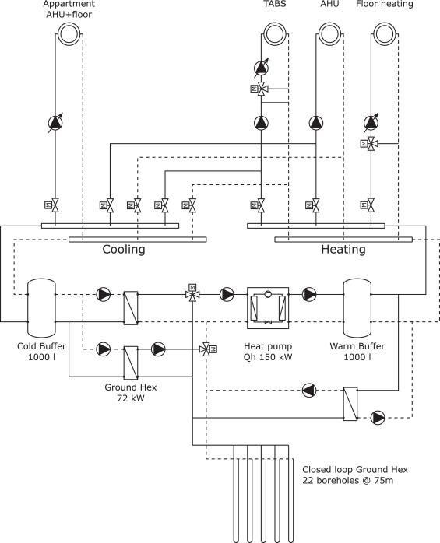
Modern HVAC Systems
Modern HVAC are complex thermodynamic machines modeled as interconnected system of systems (SoS).
Example of an HVAC system in a residential building
Example of an HVAC system in an office building
Drgona J., et al., Cloud-based implementation of white-box model predictive control for a GEOTABS office building: a field test demonstration. Journal of Process Control, 2019.
Image sourced from https://basc.pnnl.gov/images/

Slide 8
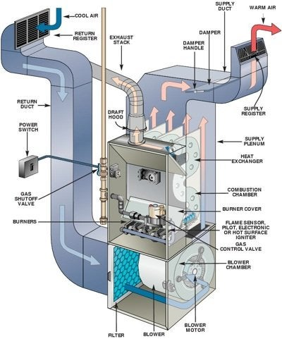
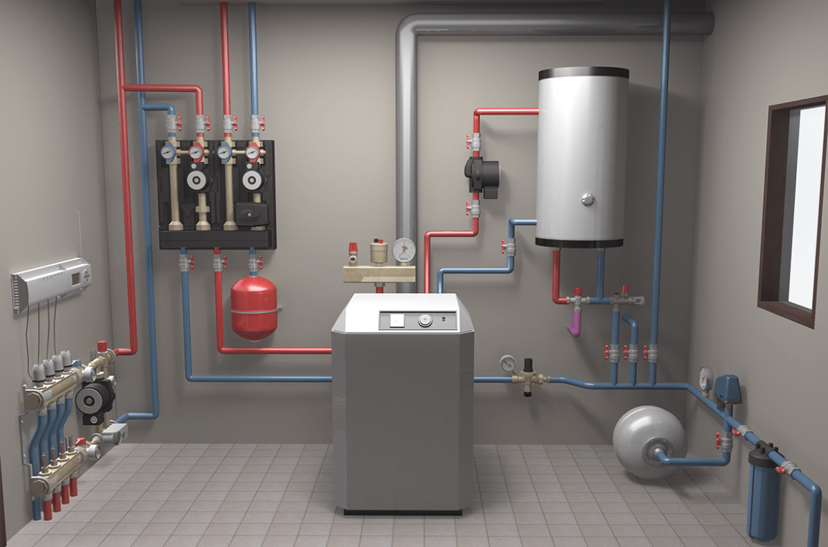
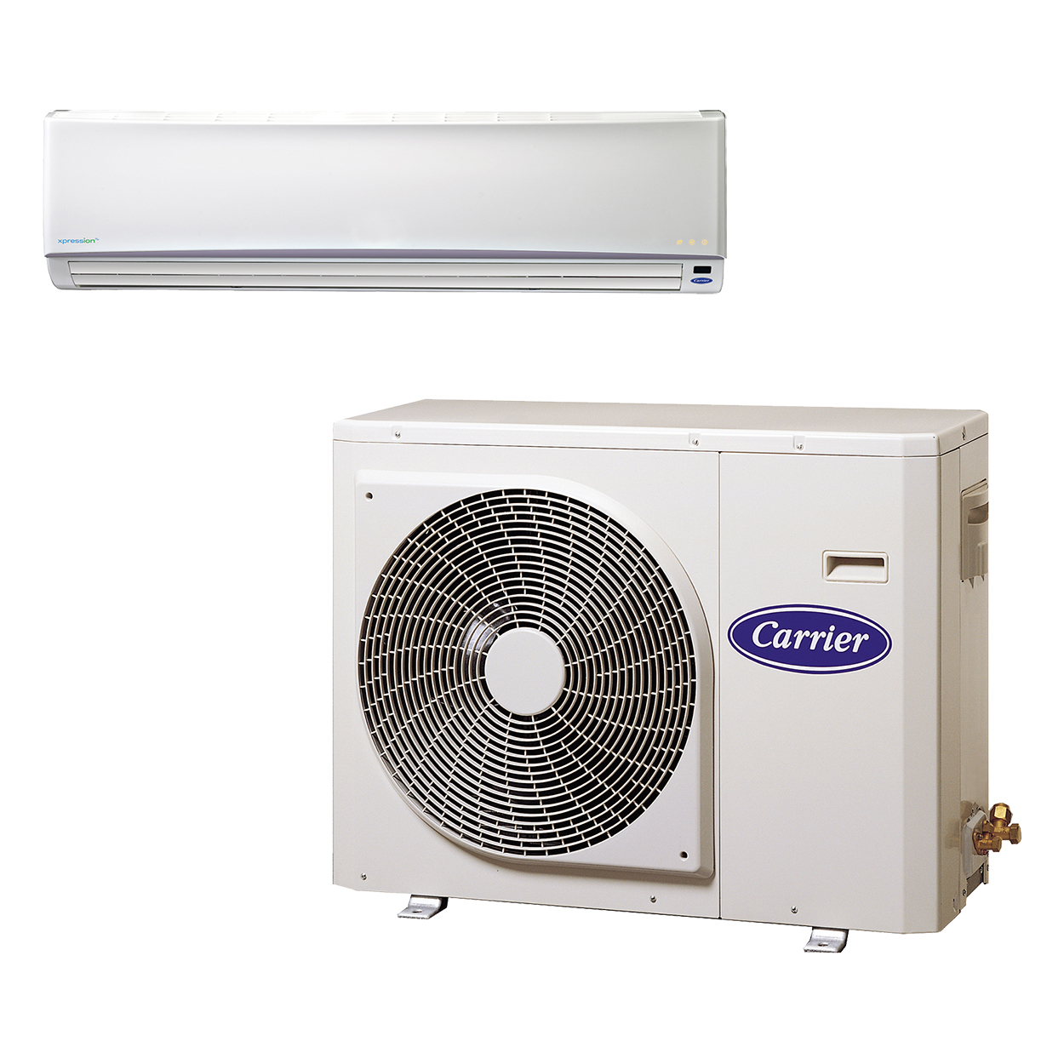
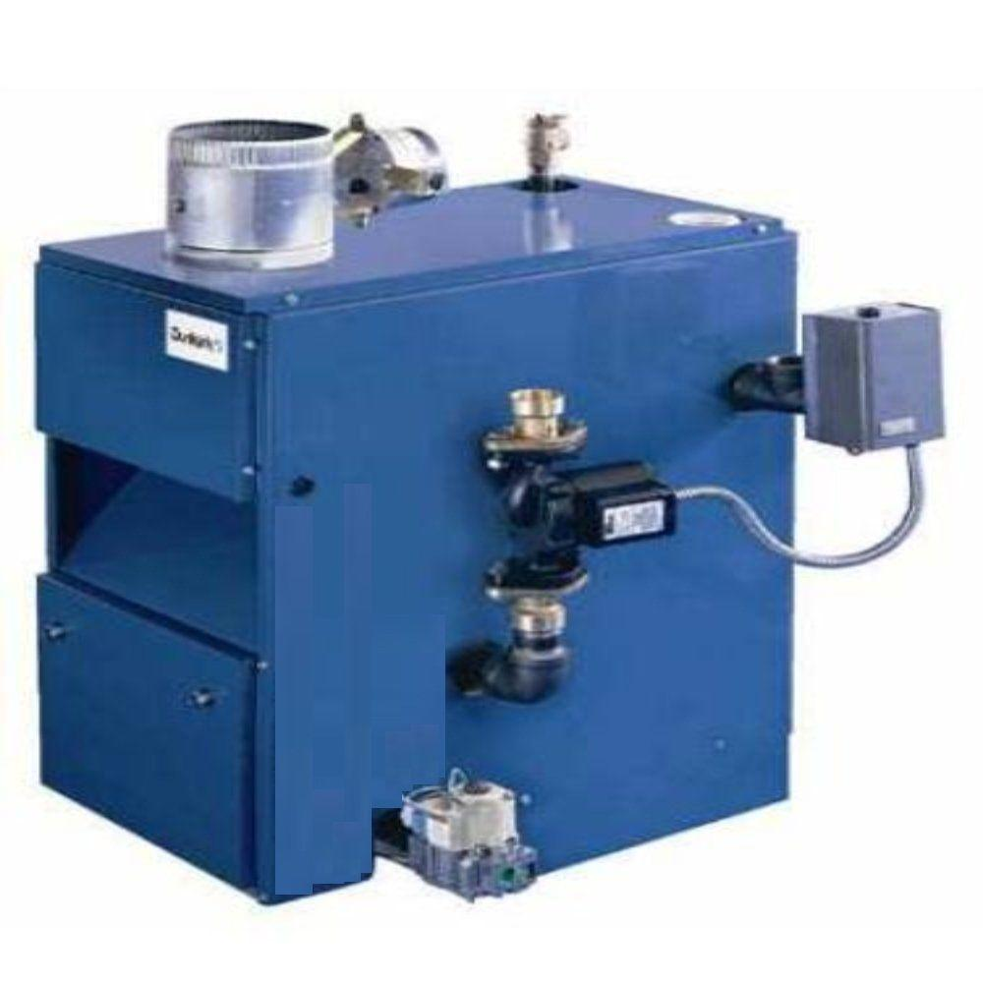
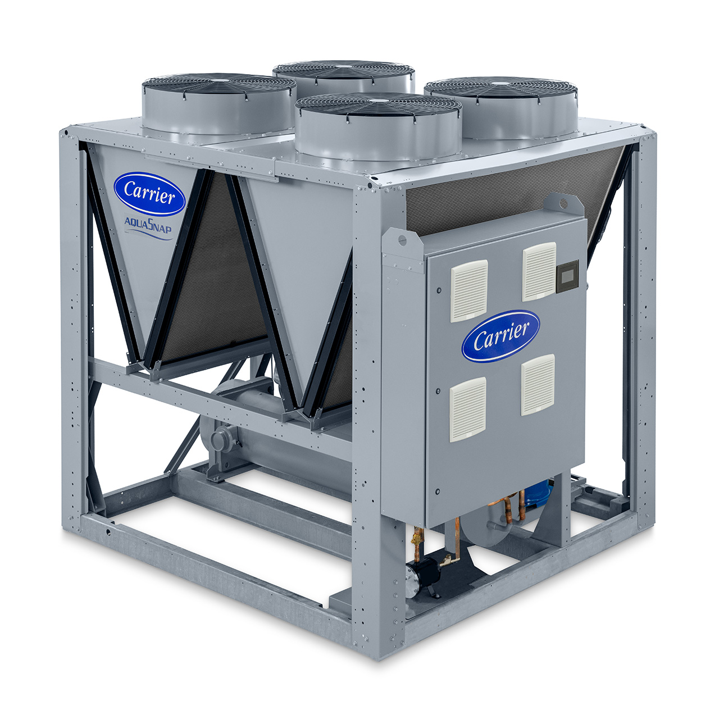
Components of Modern HVAC Systems
Heating systems
Furnaces
Boilers
Heat pumps
Domestic hot water tank (DHW)
Ventilation systems
Natural ventilation (windows, vents)
Mechanical ventilation (fans, ducts)
Air Conditioning systems
Central air conditioning
Chillers
Split systems
Control systems
Thermostats
Building management systems (BMS)
Typical residential heating system
Forced Hot Air Heating
Split System
Chiller
Boiler
https://centralplumbingandheating.com/types-of-heating/ https://www.wired.com/story/why-you-the-planet-need-heat-pump/

Slide 9
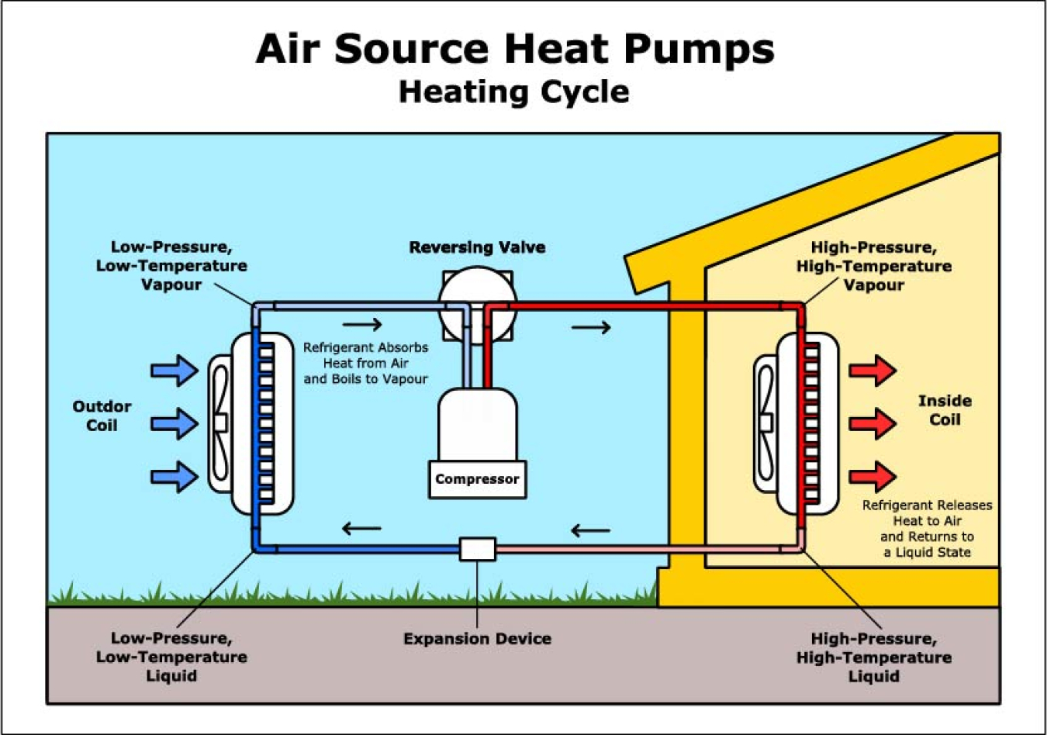
Heat Pump (HP) Principles
Refrigeration Cycle: is the foundation of HVAC systems. It involves the transfer of heat from a cooler space (a room) to a warmer environment (the outside air). The four main components of this cycle are:
Evaporator (Heat absorption): The refrigerant absorbs heat from the environment and evaporates (isothermal expansion) thus cooling the space.
Compressor (Work input): The refrigerant gas is compressed to a higher pressure and temperature. Condenser (Heat rejection): The high-pressure, high-temperature refrigerant gas releases the absorbed heat to the environment.
Expansion Valve (Throttling process): The refrigerant passes through an expansion valve where its pressure is reduced (isenthalpic expansion), causing it to cool further.
Coefficient of Performance (COP): a measure of the efficiency of a refrigeration cycle. It is defined as the ratio of heat transferred to the work input. COP of a HP is ranges from 3 to 7!
https://https://www.energy.gov/energysaver/air-source-heat-pumps

Slide 10
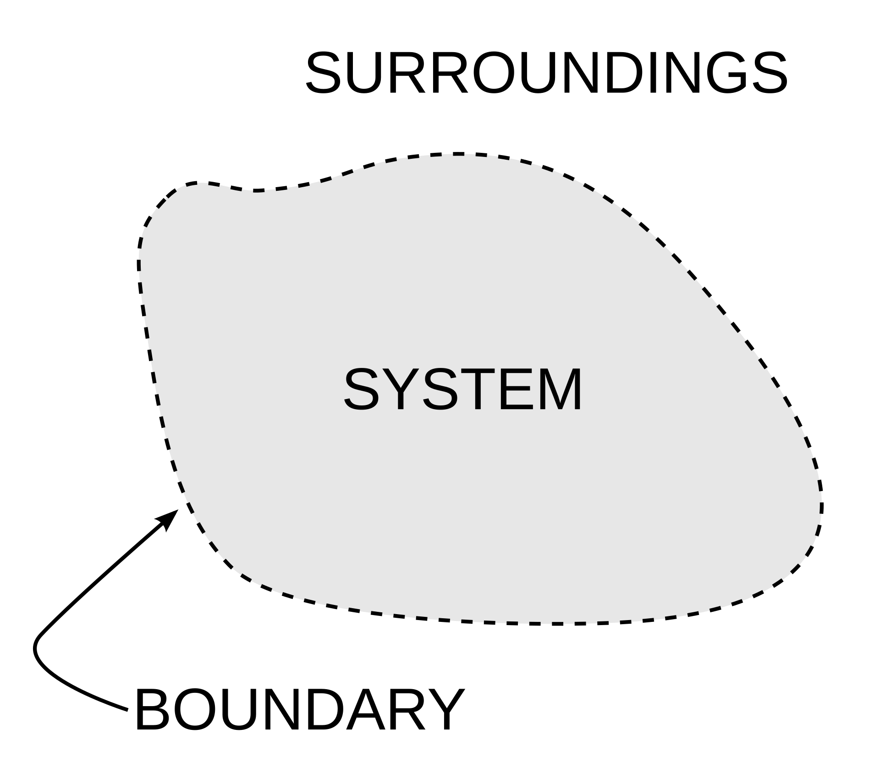
Basic Terminology of Thermodynamics
Thermodynamics deals with energy, heat, and work, and their interactions with matter. It plays a fundamental role in understanding how energy systems function, including those in HVAC systems. Key concepts in thermodynamics include:
System: part of the object under study (e.g., HVAC system).
Surroundings (environment): outside of a system.
State: condition of a system (e.g., pressure, temperature).
Equilibrium: when there are no net changes in states over time.
Process: The transformation from one state to another.
Energy: The ability to do work or produce change.
Work (W): Energy transfer due to force acting on an object.
Heat (Q): Energy transfer due to a temperature difference.
Thermodynamic potential: A scalar quantity used to represent the thermodynamic state of a system.
Internal Energy (U): Total energy stored within a system due to molecular motion and configuration.
Enthalpy (H): Sum of internal energy and the product of pressure and volume.
Entropy (S): Measure of energy dispersal or randomness in a system.

Slide 11
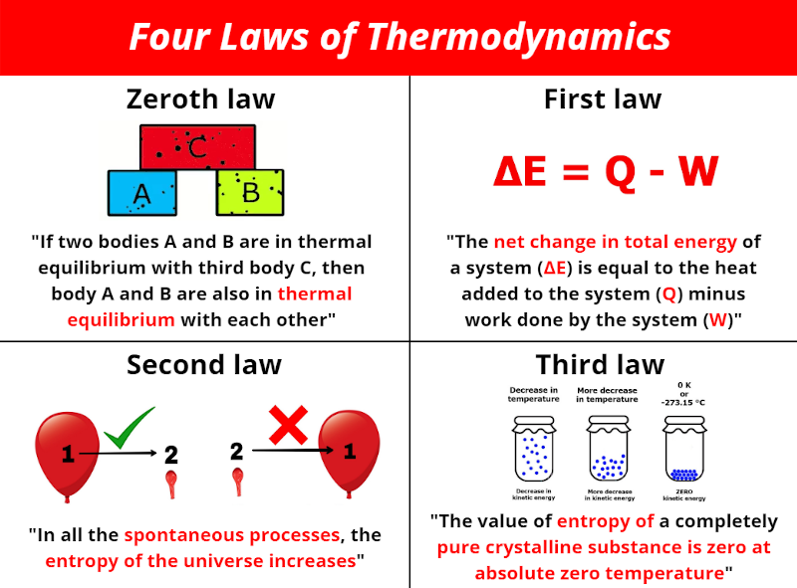
Thermodynamics Laws
Zeroth Law (Thermal Equilibrium): If two systems are in thermal equilibrium with a third system, they are in thermal equilibrium with each other.
First Law (Conservation of Energy): Energy cannot be created or destroyed; it can only change forms.
Second Law (Entropy and Direction of Processes): Heat flows naturally from a hot body to a cold one, not the reverse. Systems tend to move toward a state of maximum entropy (disorder).
Third Law (Absolute Zero): The entropy of a perfect crystal approaches zero as the temperature approaches absolute zero.
https://lawofthermodynamicsinfo.com/laws-of-thermodynamics/ https://en.wikipedia.org/wiki/Thermodynamics

Slide 12
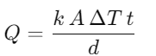
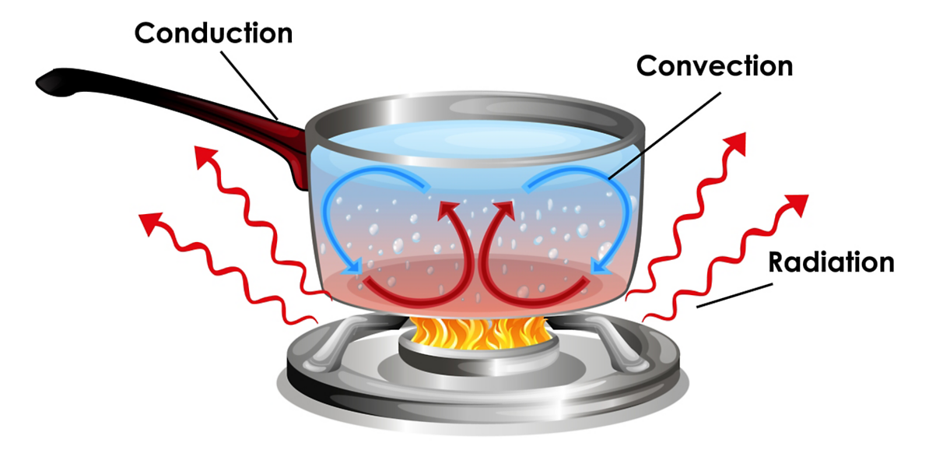
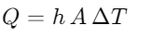
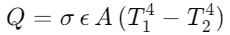
Heat Transfer Basics
Heat transfer is the movement of thermal energy due to a temperature difference.
Conduction (diffusion): Heat transfer occurs through solid materials, such as walls, or ducts.
Convection: Heat transfer occurs via fluid motion (air or liquid) in ducts or rooms.
Radiation: Heat transfer occurs via electromagnetic waves, without requiring a medium.
Variables and constants:
Q: Heat flow (W)
k: Thermal conductivity of the material (W/m·K)
A: Surface area (m²)
ΔT: Temperature difference (K)
t: Time (s)
d: Thickness of the material (m)
h: Convective heat transfer coefficient
σ: Stefan-Boltzmann constant
ϵ: Emissivity of the surface
T₁​,T₂​: Temperatures of the bodies (K)
https://en.wikipedia.org/wiki/Heat_transfer https://www.ansys.com/simulation-topics/what-is-heat-transfer

Slide 13
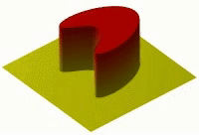
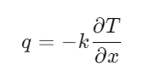
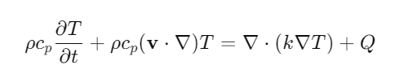
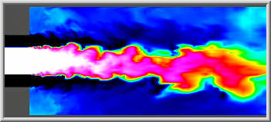
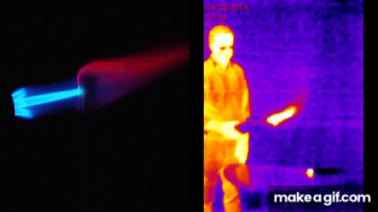
Heat Transfer Mathematical Modeling
Conduction is governed by Fourier's law:
q: heat flux (W/m²)
k: thermal conductivity of the material
∂T/∂x: ​temperature gradient in the material.
https://en.wikipedia.org/wiki/Thermal_conduction
Convection is governed by Navier-Stokes equations with thermal effects:
ρ: fluid density (kg/m³)
c_{p}​: specific heat at constant pressure (J/kg·K)
v : velocity vector of the fluid (m/s)
k: thermal conductivity of the fluid (W/m·K)
Q : heat source term (W/m³)
https://en.wikipedia.org/wiki/Convection_(heat_transfer)
Radiation is governed by the Stefan-Boltzmann law:
σ: Stefan-Boltzmann constant
ϵ: Emissivity of the surface
A: Surface area (m²)
T₁​,T₂​: Temperatures of the bodies (K)
https://en.wikipedia.org/wiki/Thermal_radiation

Slide 14
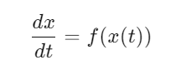
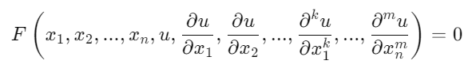
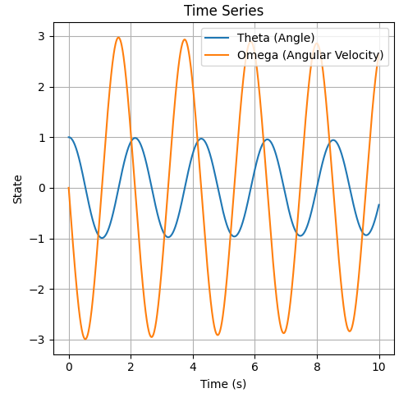
Week 3: Dynamical systems fundamentals
HVAC and heat transfer mathematical models are governed by differential equations.
Ordinary differential equations (ODEs)
Partial differential equations (PDEs)

